Slide 1
Report Week 7
SCHOOL OF MECHANICAL AND AEROSPACE ENGINEERING
Doan Manh Hung
Oct 10th, 2014

Slide 2
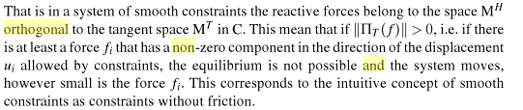
Make no resultant
Linear combination
Orthogonally

Slide 3
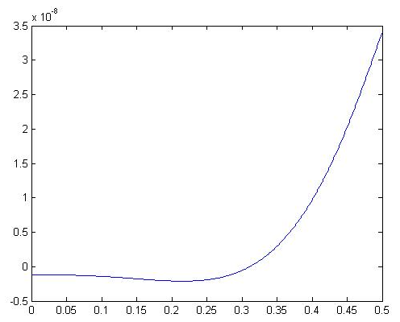
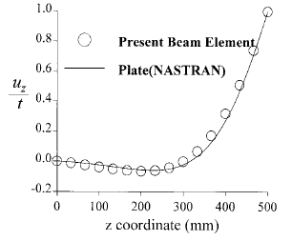
Warping displacement obtained in example 1

Slide 4
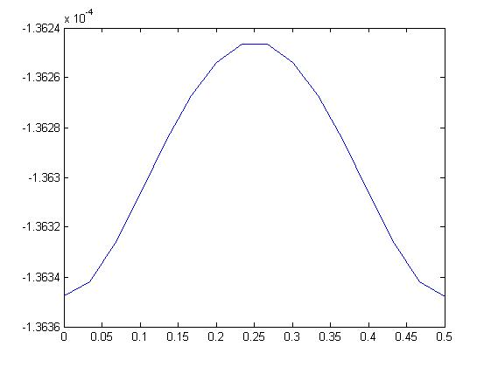
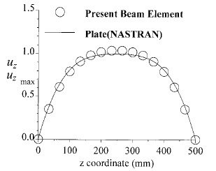
Warping displacement obtained in example 2

Slide 5
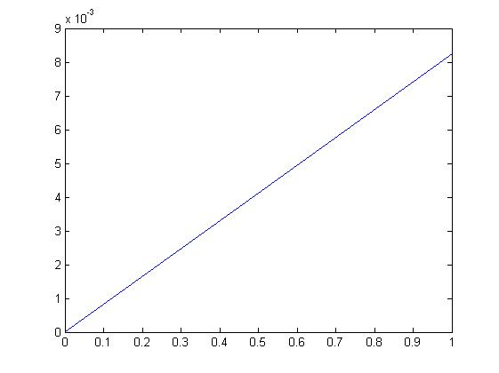
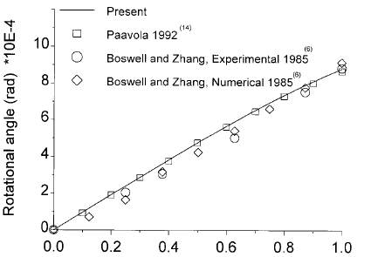
Rotation angle obtained in example 3

Slide 6
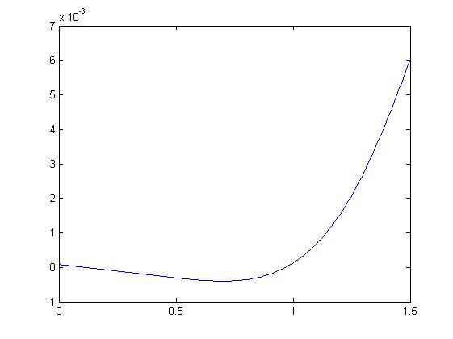
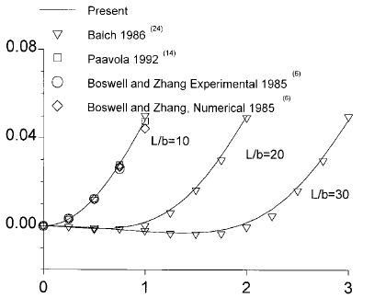
Distortion angle obtained in example 3

Slide 7
Going to do next week: - Finish the example in 2 paper

